Slide 1

Calder Lund
Dhanish Kakkar
Tianchang Zhang
Alex Xu
BBall Analytics

Slide 2
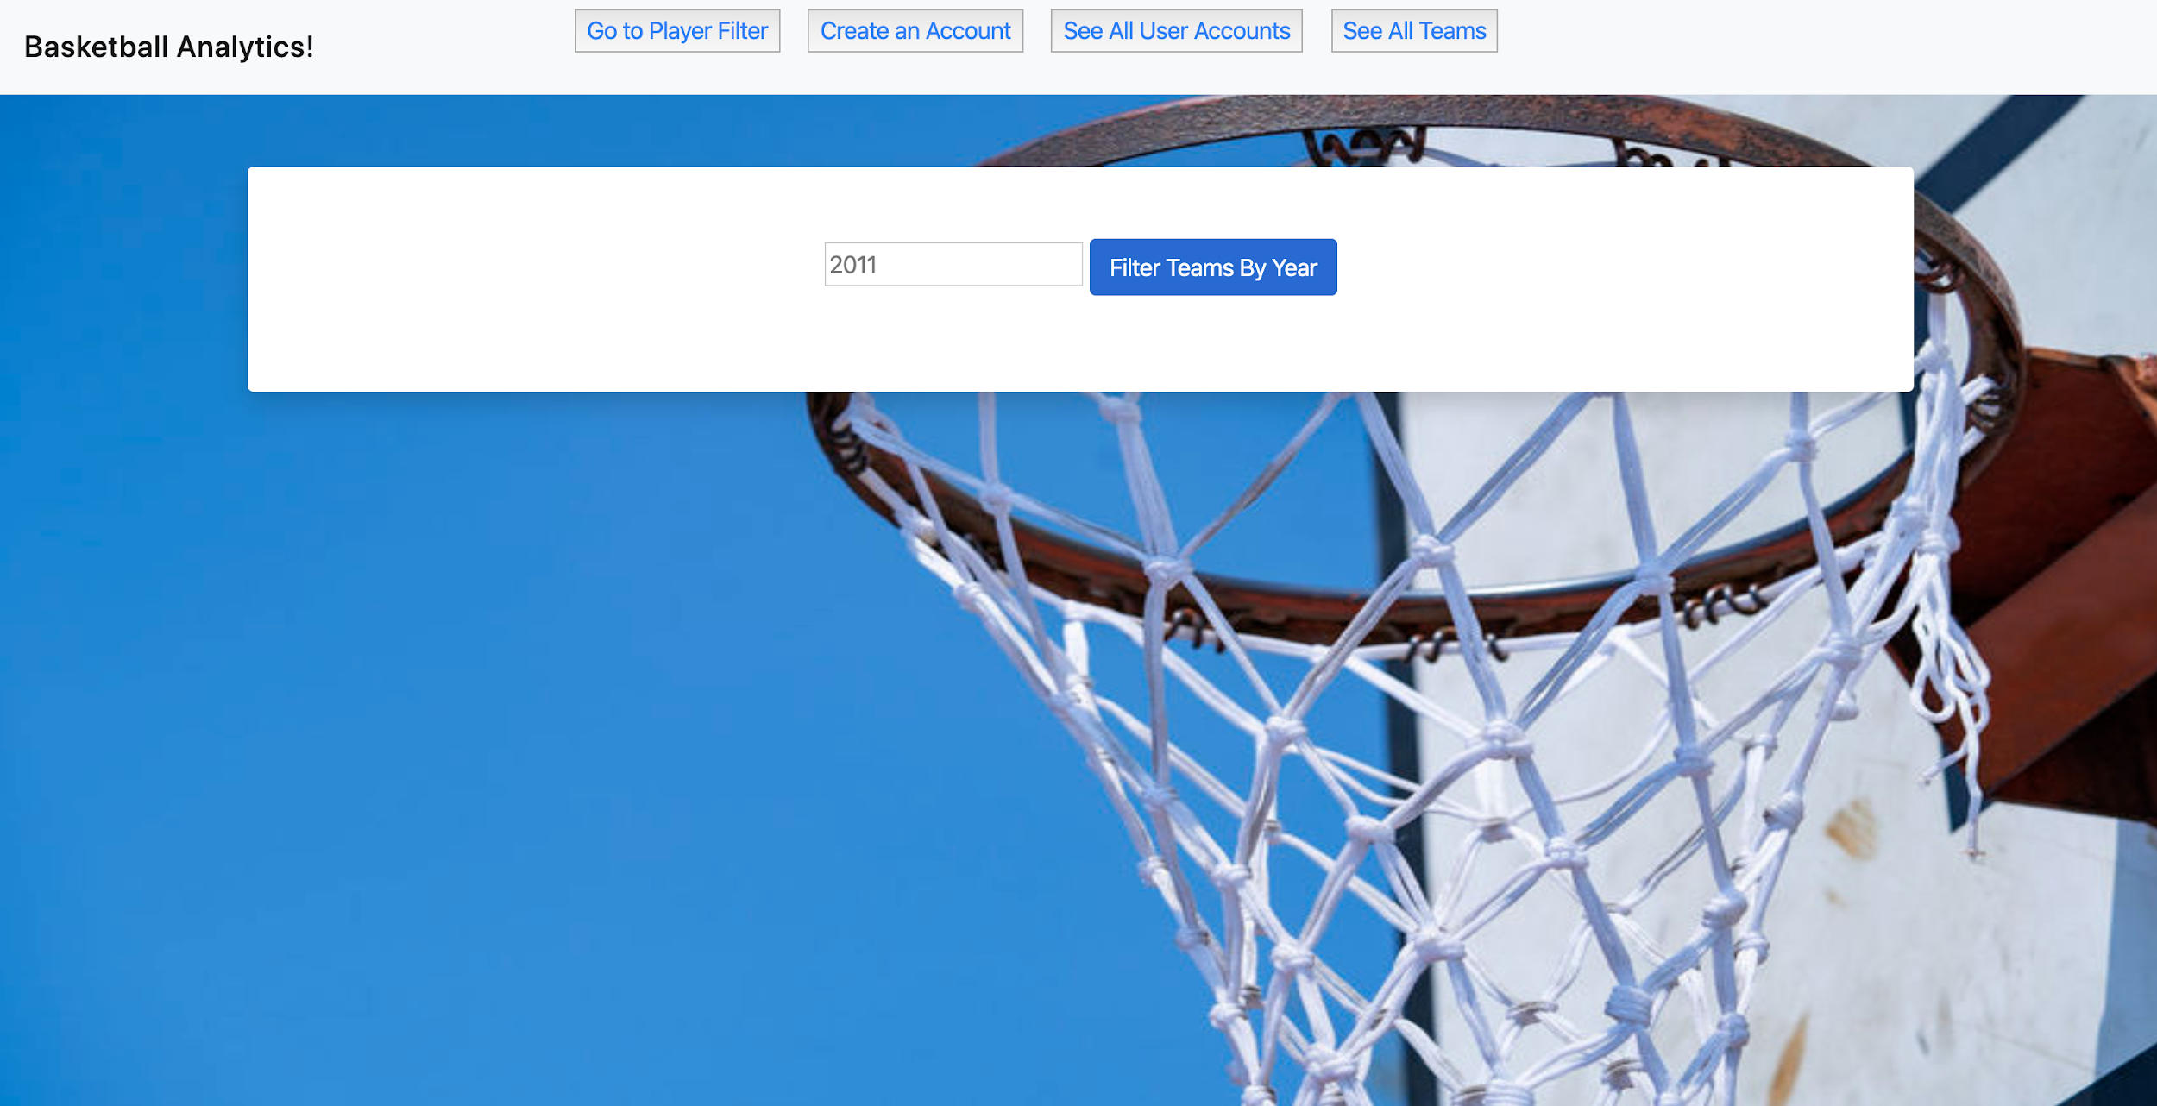

Features
NBA Season Statistics
User Account
Favourite Player
Favourite Team
Fantasy Team
Team Evaluator
Player Filter
All Time Leaders
Advanced Metrics
For further information, go to https://bball-analytics.appspot.com/

Slide 3
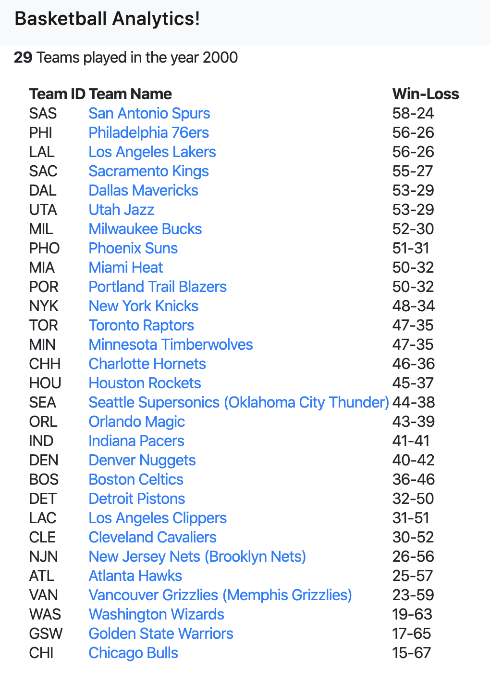
NBA Season Statistics
View standings of teams in a given year
User can click on teams to see their players in the given time year
Clicking on a player will display their statistics for that season

Slide 4
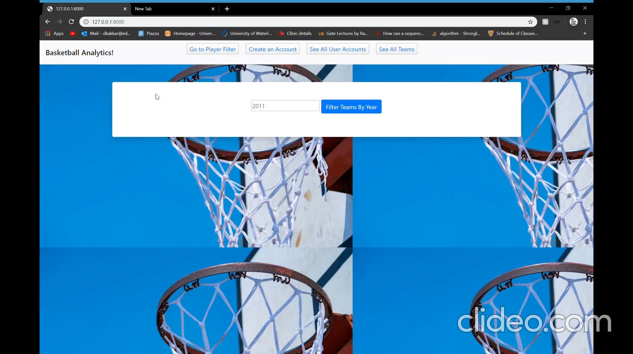
Video Demo for NBA Season Statistics

Slide 5
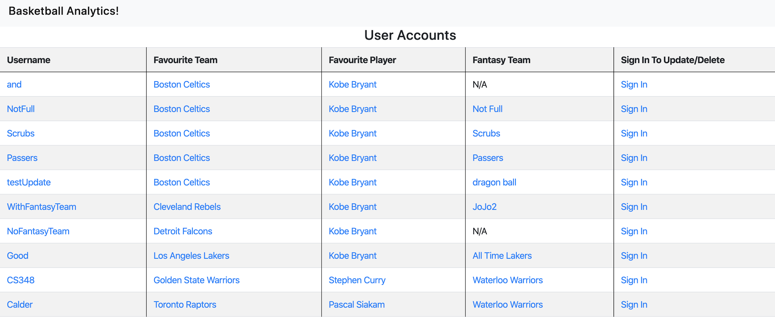
User Account
Users can create personal accounts to keep tracking of their favourite teams, favourite player and fantasy team.
Sign in to update/delete the account

Slide 6
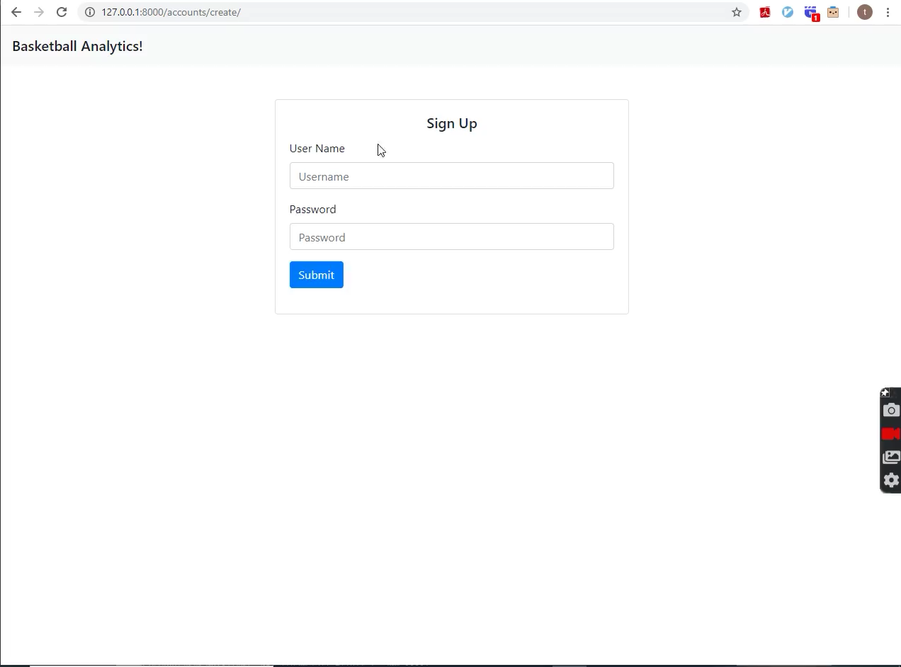
Video Demo for User Account

Slide 7
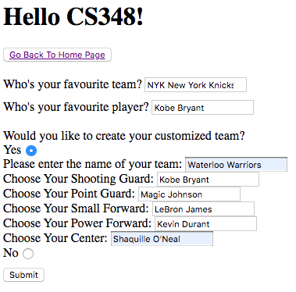
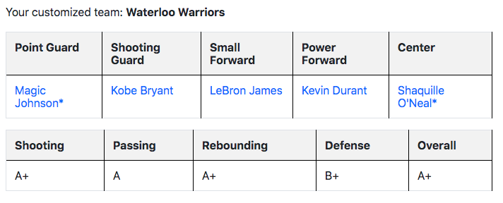
Fantasy Team
In addition to keeping track of their favourite teams and players, they can:
Build custom fantasy team
Assign 5 players to any position
Track each player’s statistics over their careers
Evaluate their team score in each major category

Slide 8
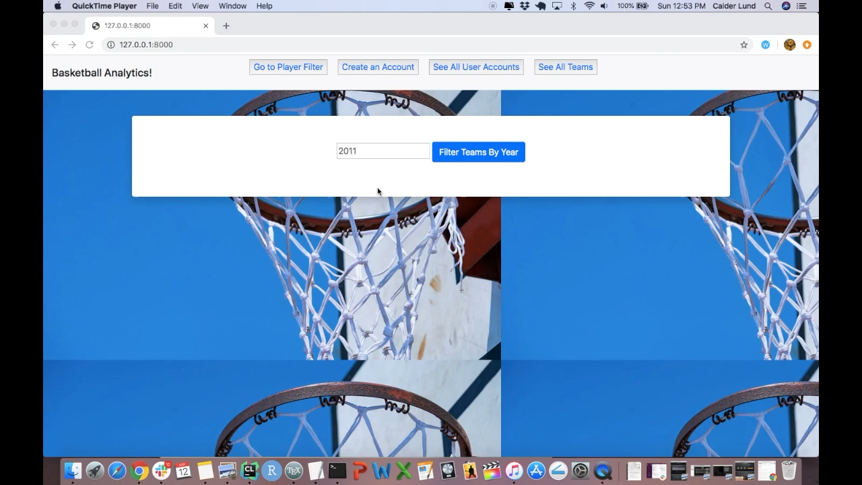
Video Demo for Fantasy Team

Slide 9
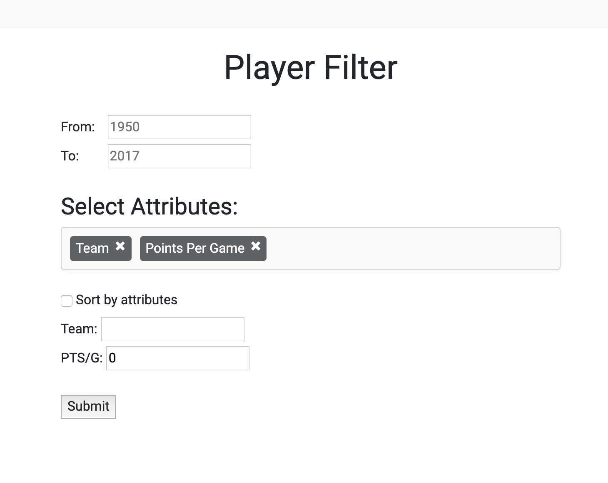
Player Filter
Basic Functionality
Allow user to filter players based on year, team, point per game and etc.
E.g. Get all point guards have played on Raptors in years 2015-2017
Advanced Metrics
Compute additional filter attributes based on original data
E.g. Points per 36 minute
All Time Leaders
Allow user to get NBA top players
E.g. Get all time player efficiency rating leaders in years 2010-2015

Slide 10

Video Demo for Player Filter

Slide 11
Contribution of Each Member
Alex - Player filter, advanced matrix and all time leaders
Dhanish - Season Statistics feature
Tianchang - User Account
Calder – Fantasy team and team evaluator

Slide 12

Thank you!

